Slide 1
JD+ on Github
ESTP Training

Slide 2

https://github.com/jdemetra/

Slide 3
GitHub specifics
git web-based hosting
« Social coding »
Issue tracking
Pull request
Wiki

Slide 4
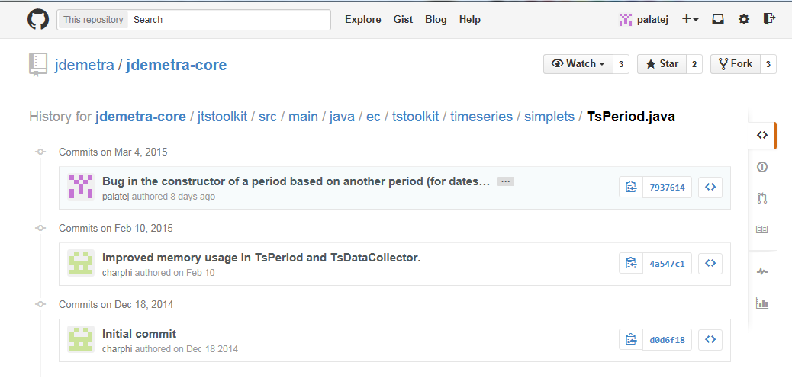
git web-based hosting
Git is a distributed revision control system with an emphasis on speed, data integrity, and support for distributed, non-linear workflows. [Wikipedia]

Slide 5
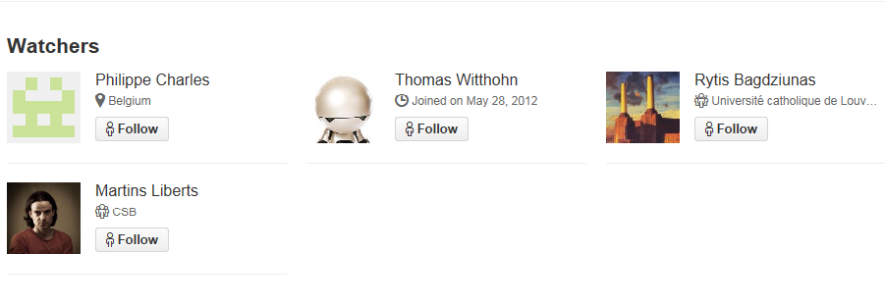
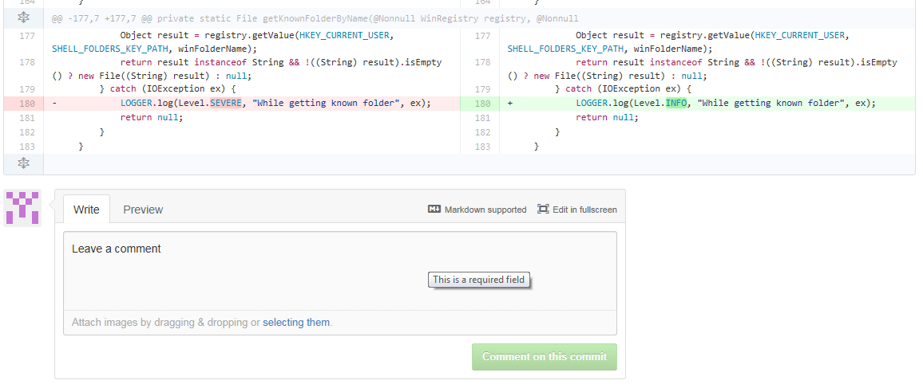
« Social coding »

Slide 6
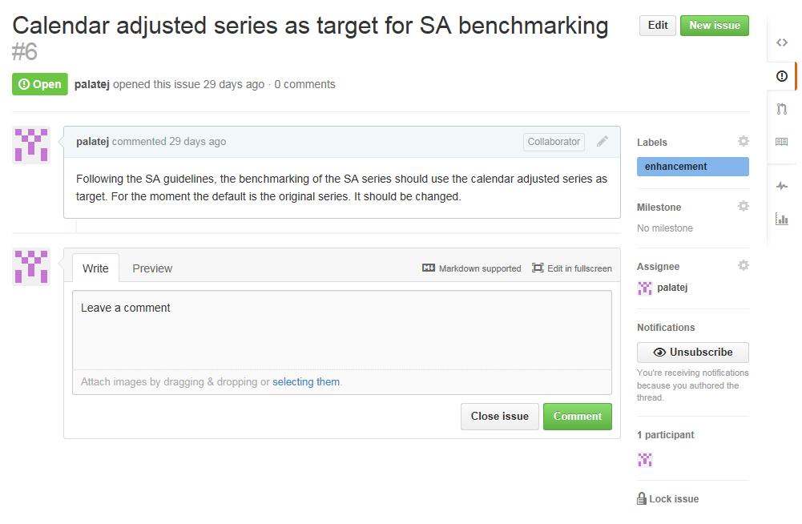
Issue tracking

Slide 7
Pull request
Main steps
Create the feature in a dedicated branch in a local repository
Push the branch to a public repository (on Github)
Create a pull request (on Github)
Review of the code, discussions, modifications bu the other developers
The project maintainer merges the feature into the official repository and closes the pull request.
Remarks:
“Social control” (everything is public)
Final decision belongs to the owner of the project

Slide 8
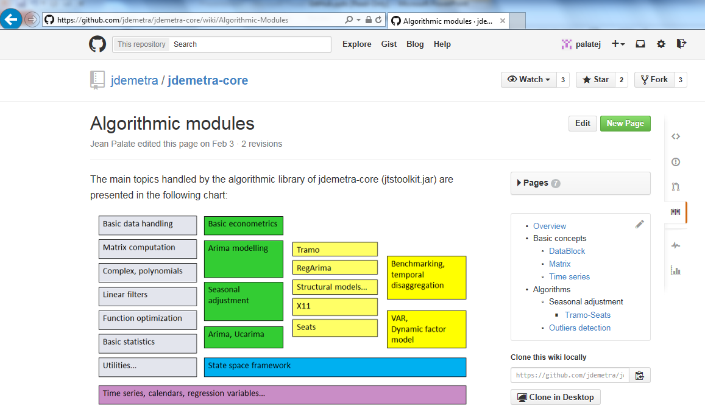
Wiki
Technical documentation on the use of the libraries

Slide 9
JDemetra3+ resources on Github
Core libraries (GUI/Cruncher)
https://github.com/jdemetra/jdplus-main
Rjdemetra
https://github.com/rjdemetra
https://github.com/rjdemetra/rjd3toolkit
https://github.com/rjdemetra/rjd3tramoseats
https://github.com/rjdemetra/rjd3x13
https://github.com/rjdemetra/rjd3providers
https://github.com/rjdemetra/rjdemetra3
Training
https://github.com/palatej/estp2023

Slide 10
JDemetra+ resources on Github
Additional plug-ins (NBB)
https://github.com/nbbrd/jdemetra-sa-advanced/releases/tag/v2.2.3
Temporal disaggregation / benchmarking (nbdemetra-benchmarking)
Structural time series (nbdemetra-sts)
…
https://github.com/nbbrd/jdemetra-dotstat/releases/tag/v2.2.5
Time series from SDMX Web services
…
Nowcasting by means of dynamic factor models

Slide 11
JDemetra+ resources on Github
New R packages (based on JD+ 3.0)
https://github.com/palatej/rjd3toolkit/releases/tag/v0.1.0
https://github.com/palatej/rjd3modelling/releases/tag/v0.1.0
https://github.com/palatej/rjd3arima/releases/tag/v0.1.0
https://github.com/palatej/rjd3sa/releases/tag/v0.1.0
https://github.com/palatej/rjd3tramoseats/releases/tag/v0.1.0
https://github.com/palatej/rjd3x13/releases/tag/v0.1.0
https://github.com/palatej/rjdemetra3/releases/tag/v0.1.0
https://github.com/palatej/rjd3sts/releases/tag/v0.1.0
https://github.com/palatej/rjd3highfreq/releases/tag/v0.1.0
Training
palatej/estp2021: ESTP training (github.com)

Slide 12
Final remarks
Powerful tool
For distributed revision control
For collaborative development
Designed for developers!
Complex tool (git)
Focus on code
Wiki, issue tracking and follow up
You could (should) contribute.

